Slide 1
SPEECH TO EMOTION RECOGNITION
TEAM TITANS,NSS COLLEGE OF ENGINEERING
AFFAN MOHAMMED N M
AKASH S
ALDAS T FRANCIS
ATHUL RAJU
REHANA K C
Mentors:
Mr.SIMAR ARNEJA
Mrs.LATHA APPANNA

Slide 2
PROBLEM STATEMENT
The goal is to build a model based on Speaker’s input and thereby finding the emotional state.
Identifying mental-wellbeing of humans.
Identifying key emotional triggers .
To study human behavior in which we extract user opinion and emotion from plain text.

Slide 3
SOLUTION
Audio message is converted into text message using Speech Recognition package.
SVM has trained to classify five different emotions.
NLP Engine is used for detecting emotion.
Web page is developed using flask,where it displays the textual form of audio as well as the emotion.
Audio
Text
Emotion

Slide 4
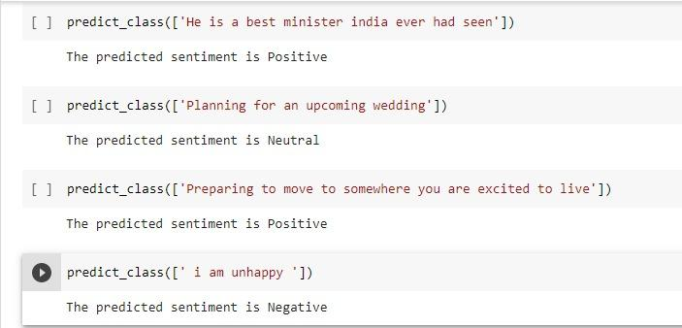
RESULT

Slide 5
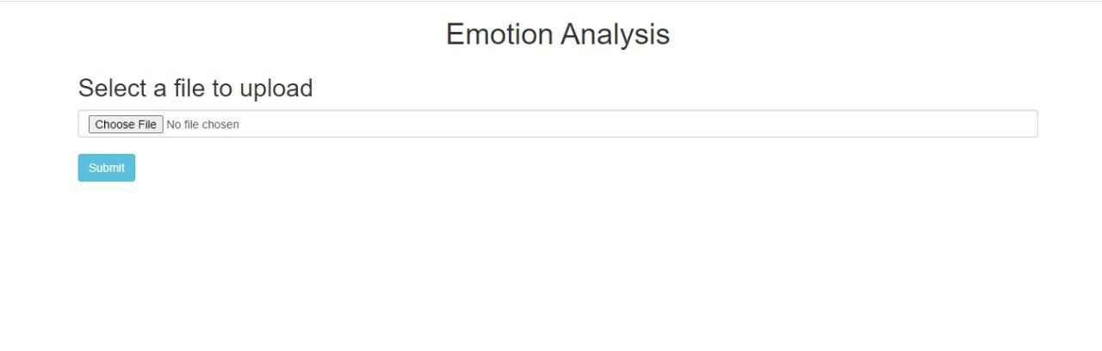
RESULT

Slide 6
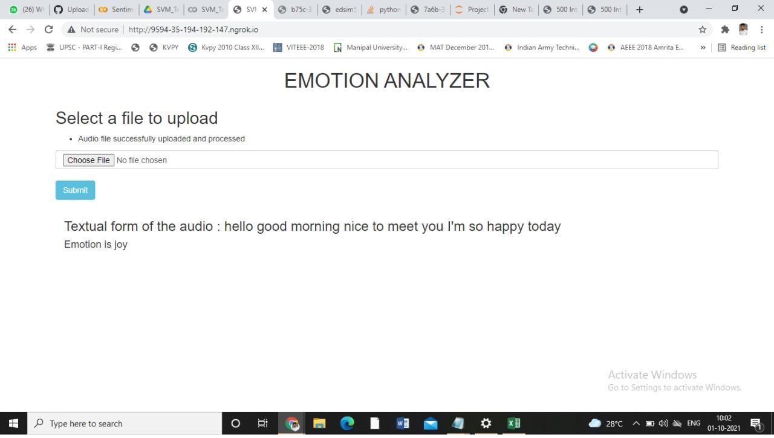
RESULT

Slide 7
REAL WORLD USE CASE
E-Commerce Industry: Analyzing the customer review as textual data from chat-bots,logs from contact centers,emails.
Counseling : Helps to find client’s emotional state.
Live insights: Customer mood can change at any point during a customer service interaction,user can see the mood of each customer in a session
E-Learning: To adjust the style of learning by detecting the emotional state of learner

Slide 8
FUTURE SCOPE
Upselling Opportunities: Happy customers are more likely to be receptive to upselling. With sentiment analysis, you can easily identify your happiest customers.
Handling multiple customers: Agents can find themselves handling more than one customer at a time.
Face Emotion Recognition
Real Time Monitoring

Slide 9
REFERENCES
https://www.kaggle.com/shivamburnwal/speech-emotion-recognition
https://realpython.com/python-speech-recognition/
https://flask.palletsprojects.com/en/2.0.x/
https://www.researchgate.net/publication/303824219_Techniques_and_Applications_of_Emotion_Recognition_in_Speech

Slide 10
Thank you
You can find me at
@username
user@mail.me

